Slide 1

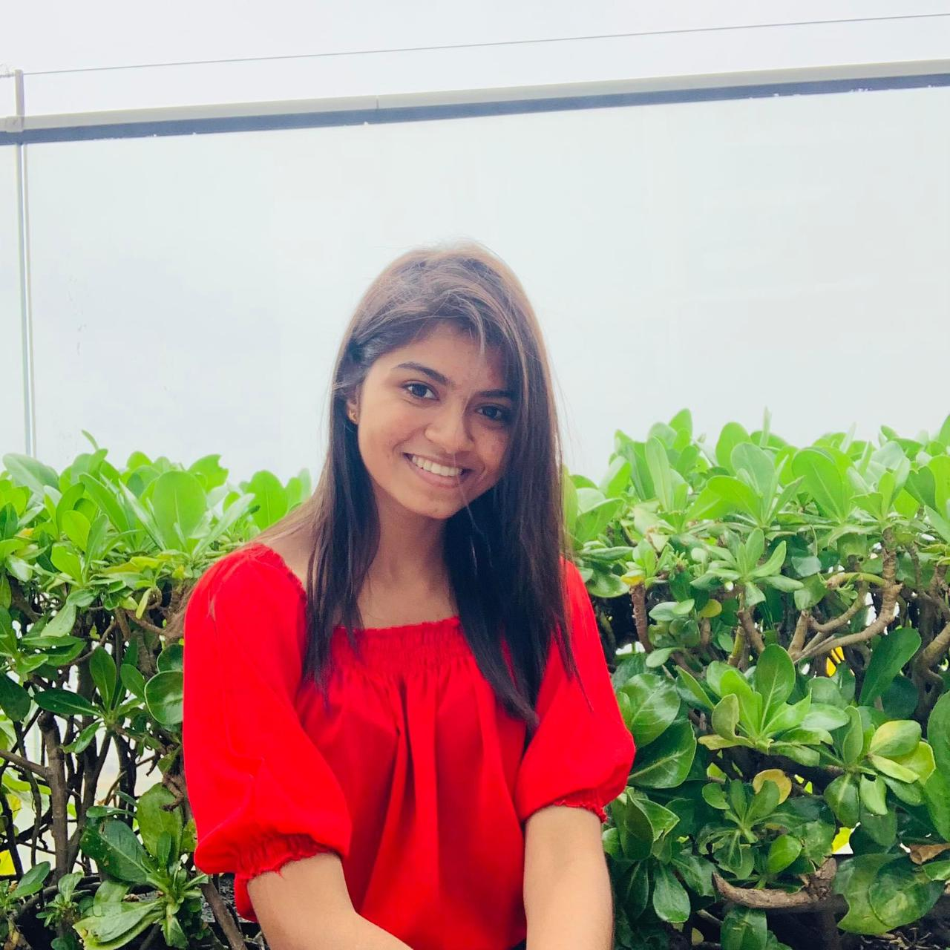

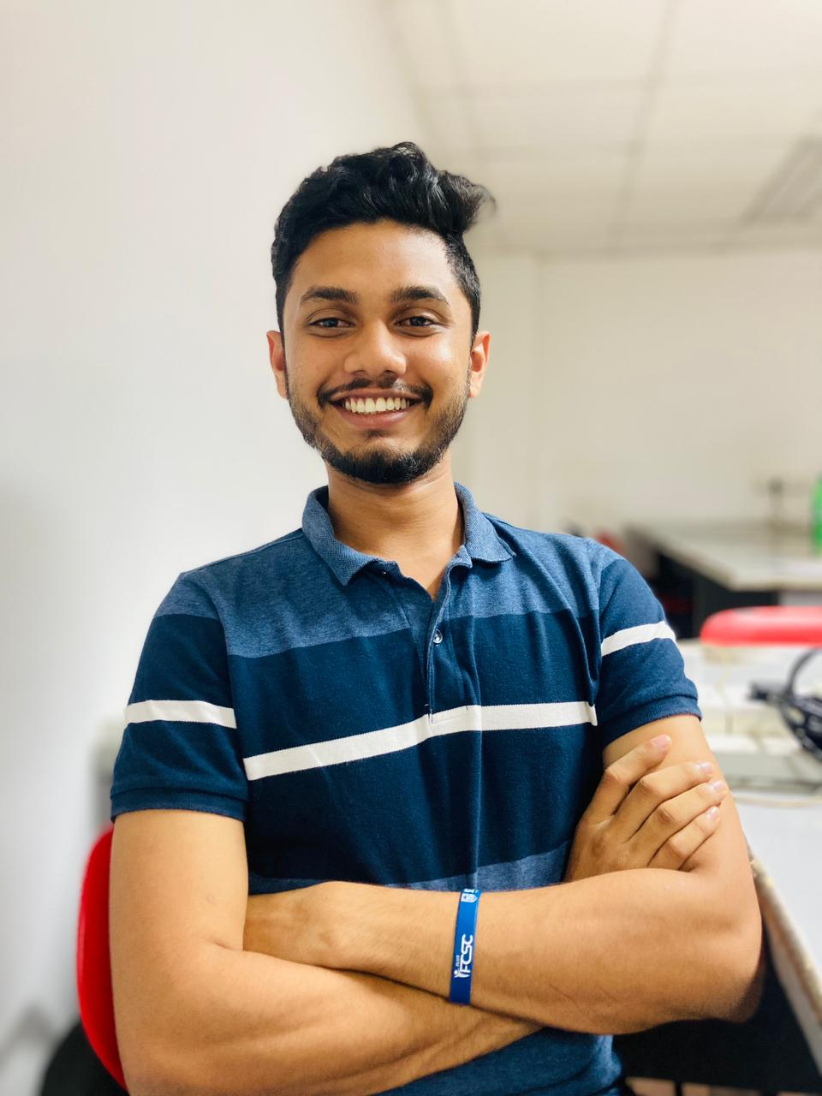
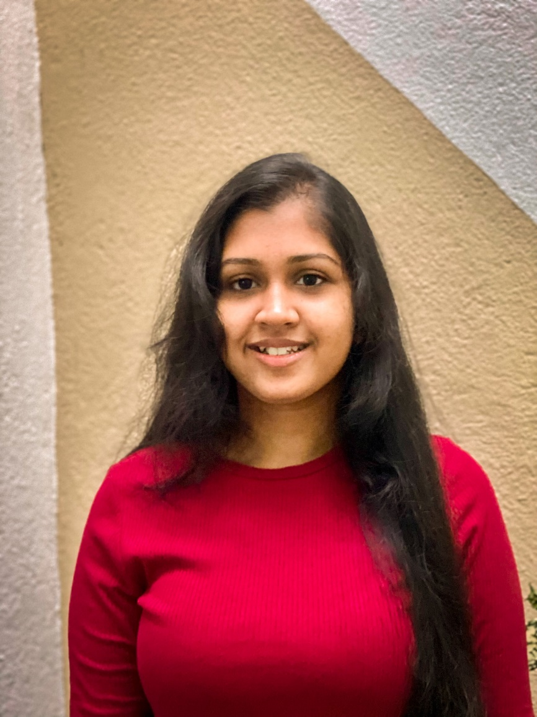
Team Autobots
Umesha Dilshani
Ishara Madusanka
Dinidu Ekanayake
Duvini Ranaweera

Slide 2

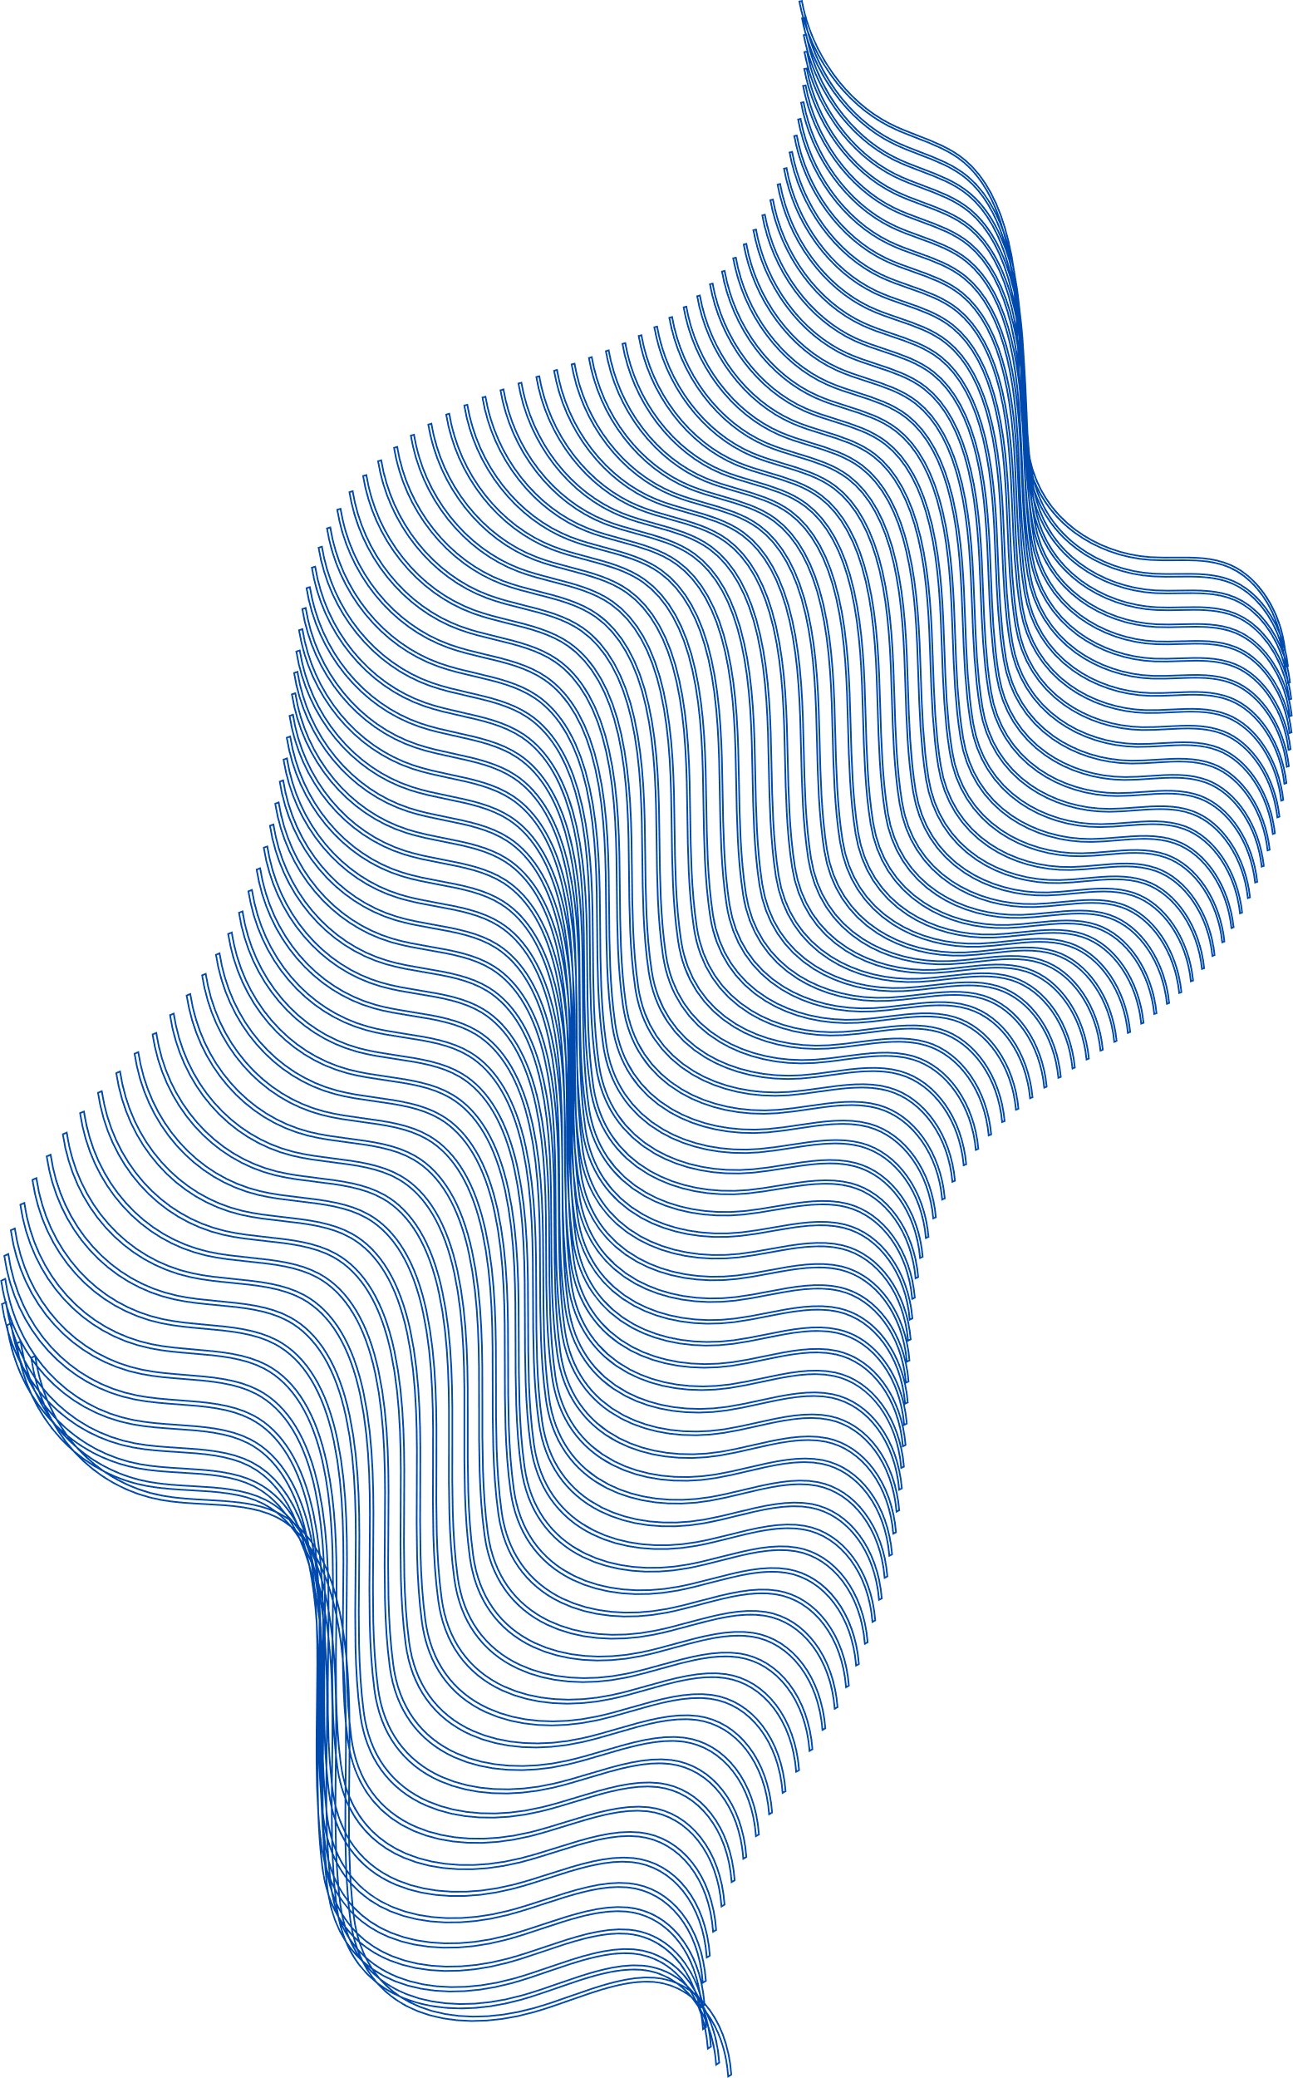
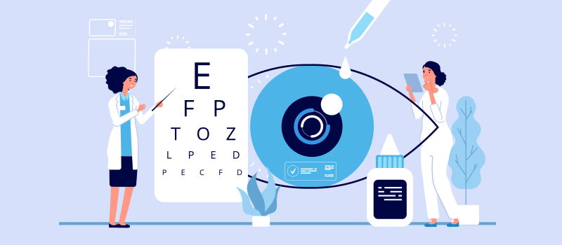
Existing Competitive Products
ICARE Vision Test
Healthy Vision
B2 Eye Test
Vision Test
Gaps in the Current Market
Mainly Targets on Adults
Early Detection of infants
Combining Indigenous and western Treatments
User Friendly Interface
EYEZEN

Slide 3



Minihackathon 2023
EYEZEN
eyezen@gmail.com

Slide 4


EYEZEN
TECHNOLOGY
Frontend – React , Tailwind CSS
Backend – Python(Flask)
User Authentication and Access Control – Azure AD
Real Time threat detection – Azure security center
Hosting – Azure app service
Store user and diagnosis details – Azure Cosmos Database
Store pictures and videos – Azure Blob service
Improve disease detection – Azure AI & ML

Slide 5
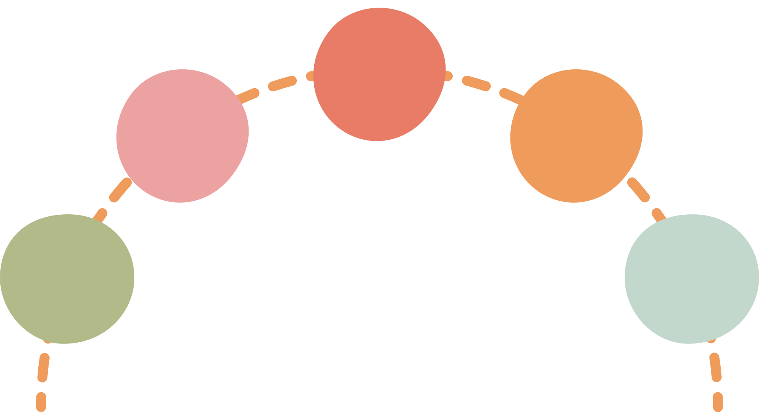


EYEZEN
Implementaion
System
Design
Testing
Client-side
Server-side
Database
Requirements
gathering
Maintenance

Slide 6
SYSTEM
FUNCTIONS
EYEZEN

Slide 7
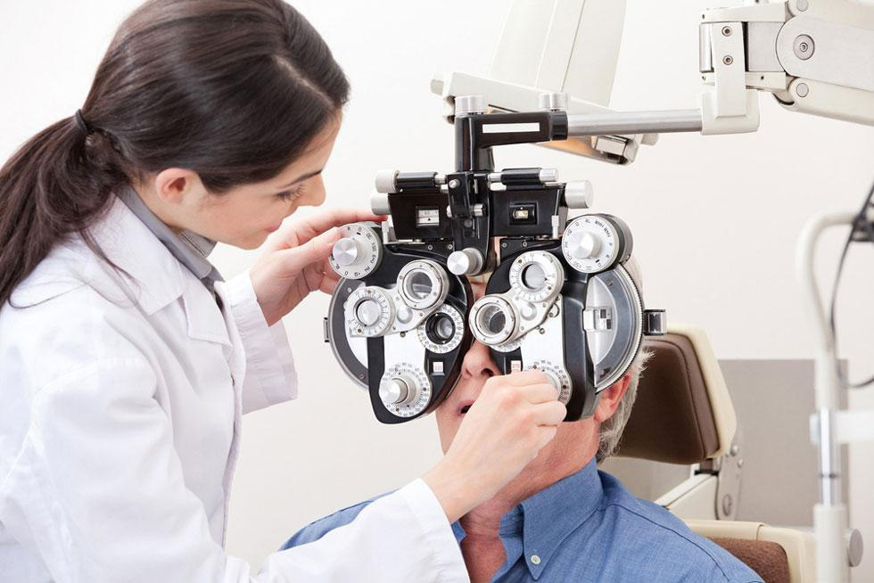
EYEZEN
VISION CHECK AND DIAGNOSIS
Vision Health Quiz
Engaging quiz to asses eye health
Analyzes answer to provide potentional diseases and probabilities
Disease Specific Tests
Users can confirm specific Vision Problems
Accurate and reliable tests for early detection

Slide 8

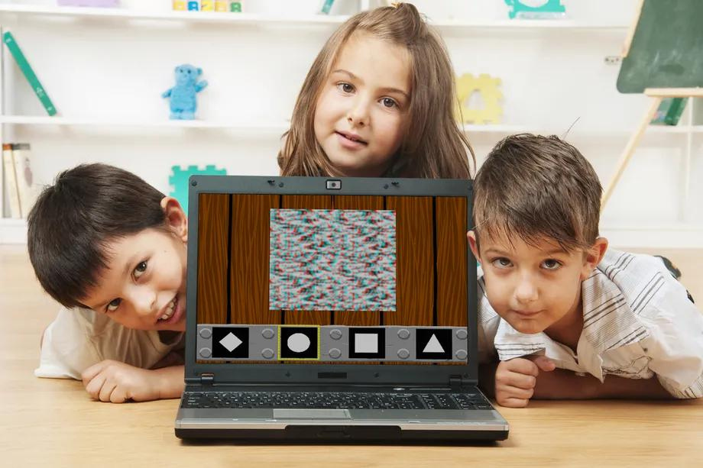
VISION CHECK WITH GAMES
Independent vision tests
Flexibility to take vision test without quizzes
Regular monitoring and tracking of eye health
EYEZEN

Slide 9
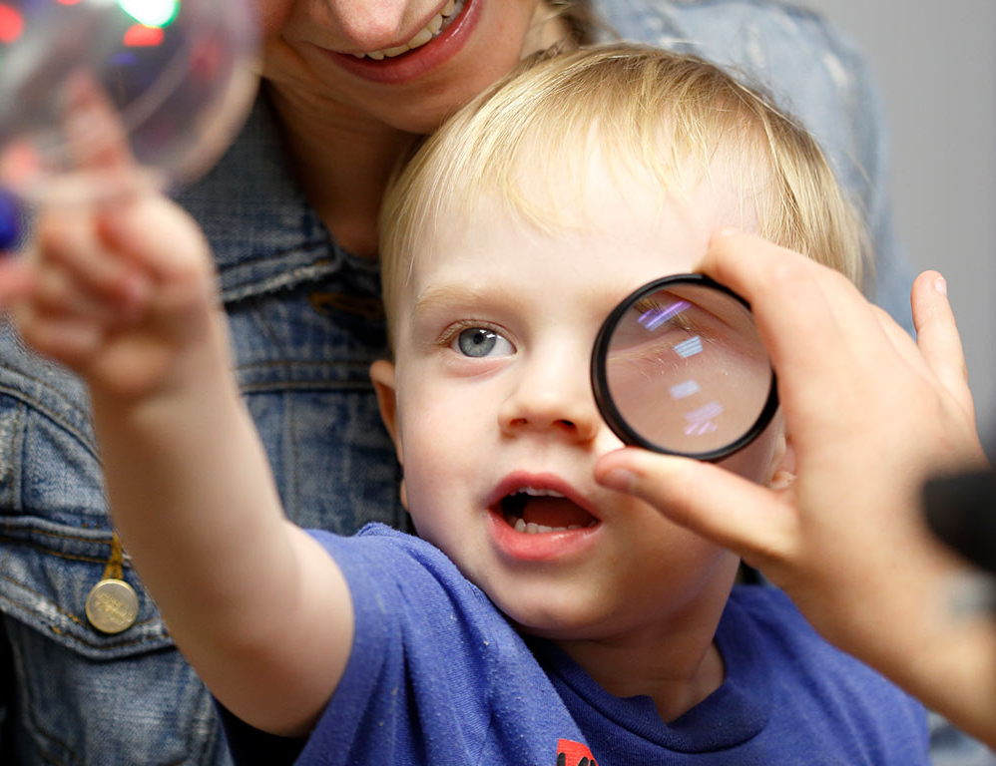
INFANT EYE CARE
Provide activities for sight detection
Evaluate results
provide disease-specific activities
EYEZEN

Slide 10

EYEZEN
AYURVRDIC EYE CARE
Ayurvedic Treatments for Eyes
Ayurvedic Articles
Eye care tips
how to improve eyesight naturally
to enhance eye health
preventive measures for better eye care
Ayurvedic eye care video tutorials
Ayurvedic eye doctor contact
FAQ

Slide 11
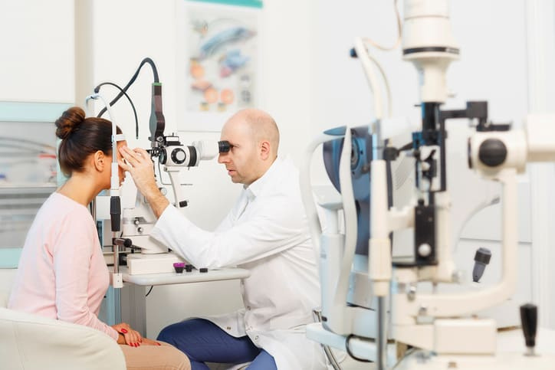
DOCTOR DETAILS
EYEZEN
Geo map
for eye doctors
for eye care centers
Contact section for Doctor contact and booking
ayurvedic doctors
normal doctors

Slide 12
THANK YOU!
EYEZEN
MINIHACKATHON 2023

